Slide 1

Flight Safety: A Graphical Analysis
Erez Sarousi
Bellevue University

Slide 2
Introduction
Scared of flying?
Are you scared of getting into a plane crash?
Do you think that we are less safe as time moves on?
Are you worried that as soon as you step on a plane, everything will go wrong?

Slide 3

Well the chances of something happening to you is infinitesimally small!

Slide 4
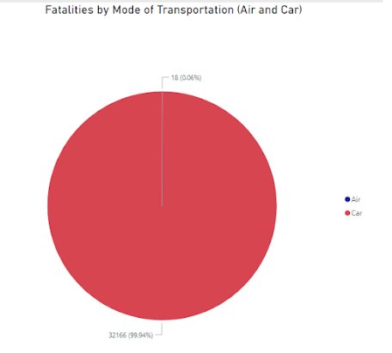
Fatalities
It is overwhelming how many more fatalities occur by car than by plane. Between 2000 – 2014, there were only eighteen fatalities.
Fatalities by air would have to be multiplied 1,787 times just to equal the fatalities that come from the mode of transportation we use every day.

Slide 5
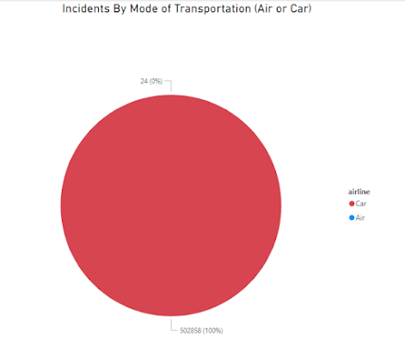
Incidents
Well surely there will be a higher percentage of incidents than fatalities, right?
Wrong. Incidents with cars occur extremely frequently and over a fifteen year period, there were only twenty-four incidents!

Slide 6
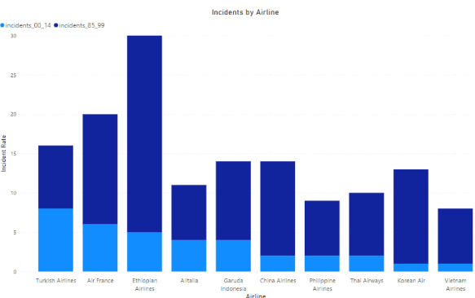
Which Airlines Should We Be Concerned With?
Ethiopian Airlines had the highest incident rate but as you can tell, all of these airlines have decreasing numbers through to the most recent timeframe.

Slide 7
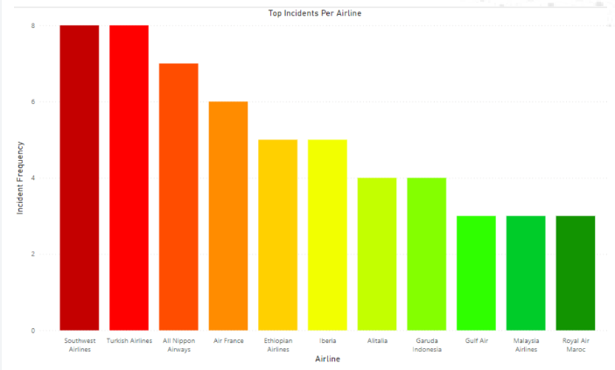
Today’s Composition
The majority of all airlines have had less than five incidents over a fourteen year period.

Slide 8
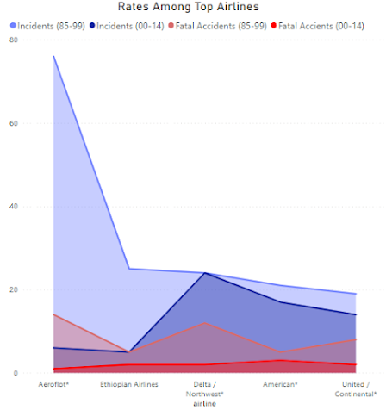
The Whole Picture
Both incidents and accidents have reduced dramatically between the two time frames. In that time, incidents decreased by over 45%, and accidents by almost 70%!

Slide 9
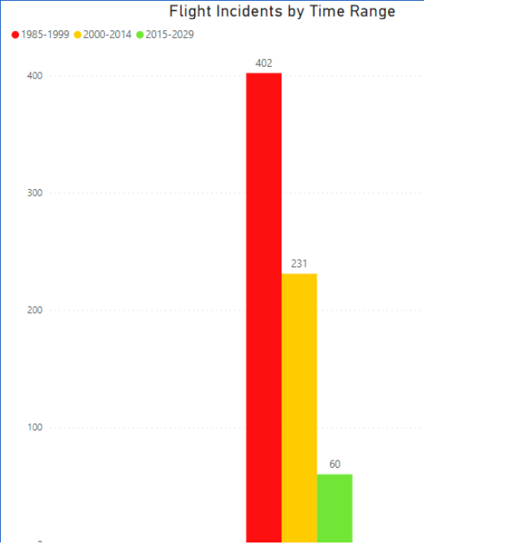
How Will These Trends Continue?
Given the rate of incident decrease between the first two time frames, we predict that 2015-2029 will only see 60 incidents. This would be a decrease of over 80%!

Slide 10
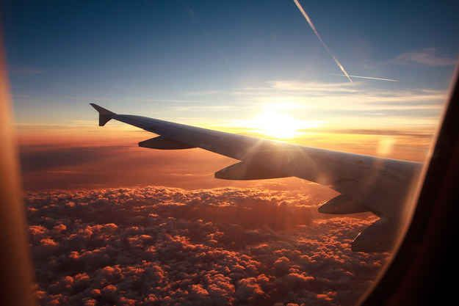
Conclusion
It is safe to fly!
You are not likely to encounter any issues on a flight.
It is even much less likely that you would die from an airplane.
We are only getting safer.
From all of us with the airline industry, we thank you for your attention.
Sit back and enjoy the beautiful sunset.
The flight staff will be over momentarily to take your drink orders.

